Slide 1
R tidyverse quick example

Slide 2
Introduction
R has had undergone a bit of a revolution of sorts in the past few years.
There has been a coordinated effort to develop a collection of code focusing on the major use cases for data science.
Posit (nee Rstudio), the developer of the well known R/python IDE, in specific, has been a major leader in this effort.
However, there have also too many additional open source contributors to even try to mention a meaningful subset.
The result is a really pleasant and easy to learn data science environment for so-called "tidy" data

Slide 3
Tidy data
Let's start with the definition of a tidy dataset. To quote:
The idea is, spend your time getting the data into a tidy format.
This will make everything that follows so much easier, from summaries to plots to analyses.
The set of tidyverse packages and functions (of course) focuses on tidy data, but nicely adds a common syntax and set of conventions.
You can install the tidyverse with the R command install.packages("tidyverse"), which only needs to be done once.
You can add the tidyverse to a conda environment with conda install -c r r-tidyverse .
{note}
Tidy data is a standard way of mapping the meaning of a dataset to its structure. A dataset is messy or tidy depending on how rows, columns and tables are matched up with observations, variables and types. In tidy data:
1. Every column is a variable.
2. Every row is an observation.
3. Every cell is a single value.

Slide 4
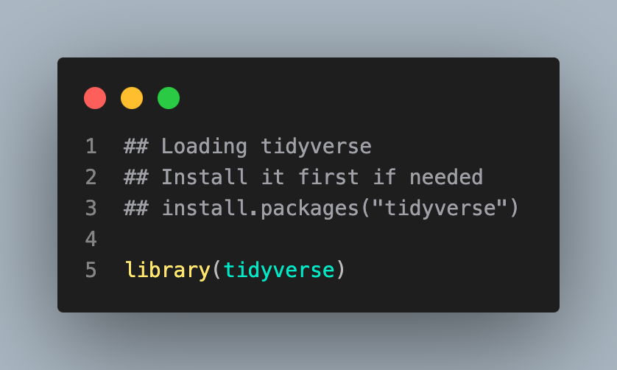
Make note of the conflict filter which is both used to filter rows a dataframe and in signal processing. The :: looks for functions in that package. You can use that if you want to quickly use a function without loading the package.

Slide 5
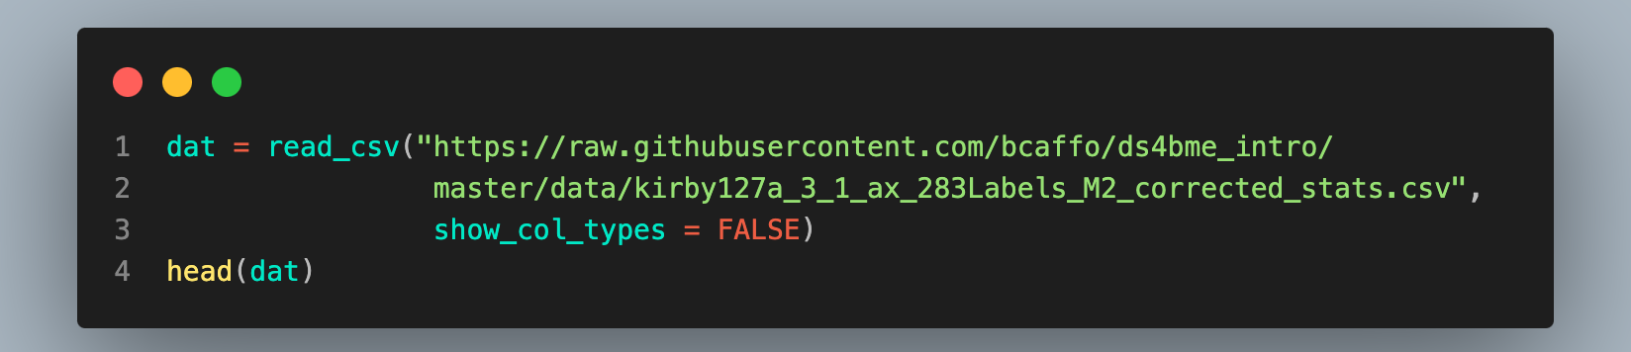
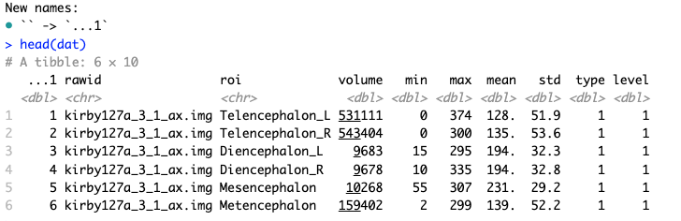
Reading in a dataset
Let's read in our data that we worked with previously. Note the function data is taken in R, so it's best not to use it to define a dataset. Better to just use dat or something like that.

Slide 6
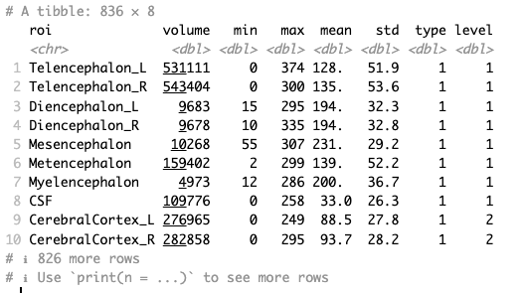
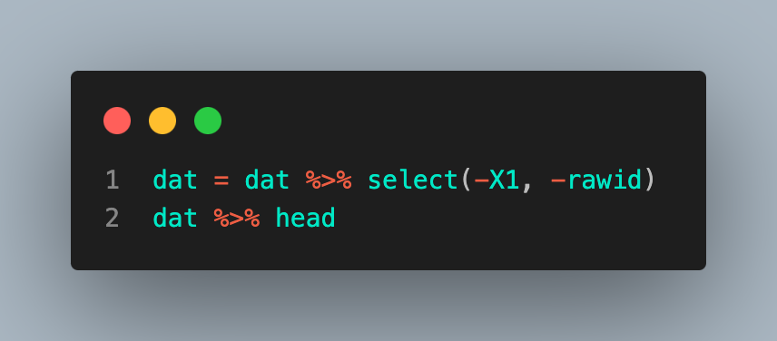
Dropping columns
Let's get rid of the X1 or rawid columns.
The pipe operator %>% is really useful. It funnels the output from the previous statement to the next.
The negative signs in front of the variables mean to remove them.

Slide 7
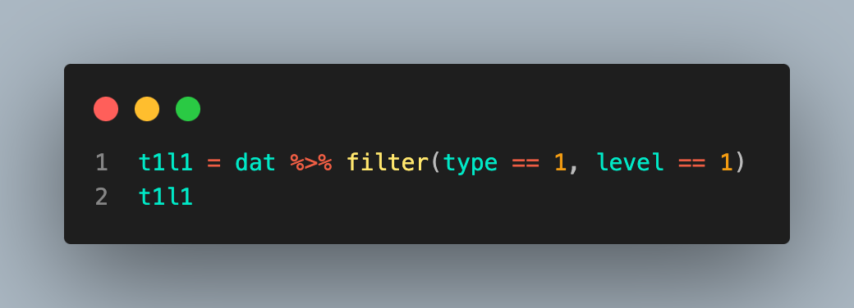
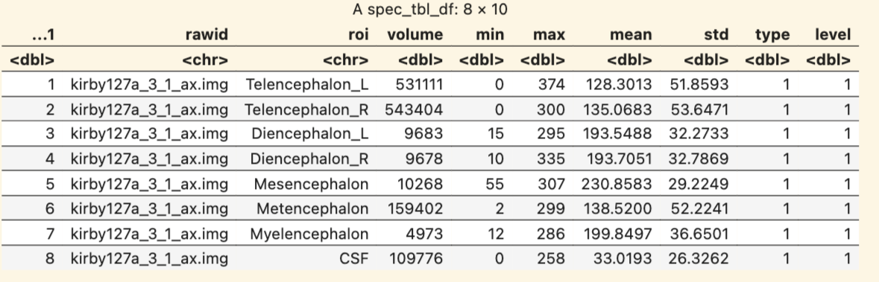
Sub-setting the data
Let's get the Type 1 Level 1 data.

Slide 8
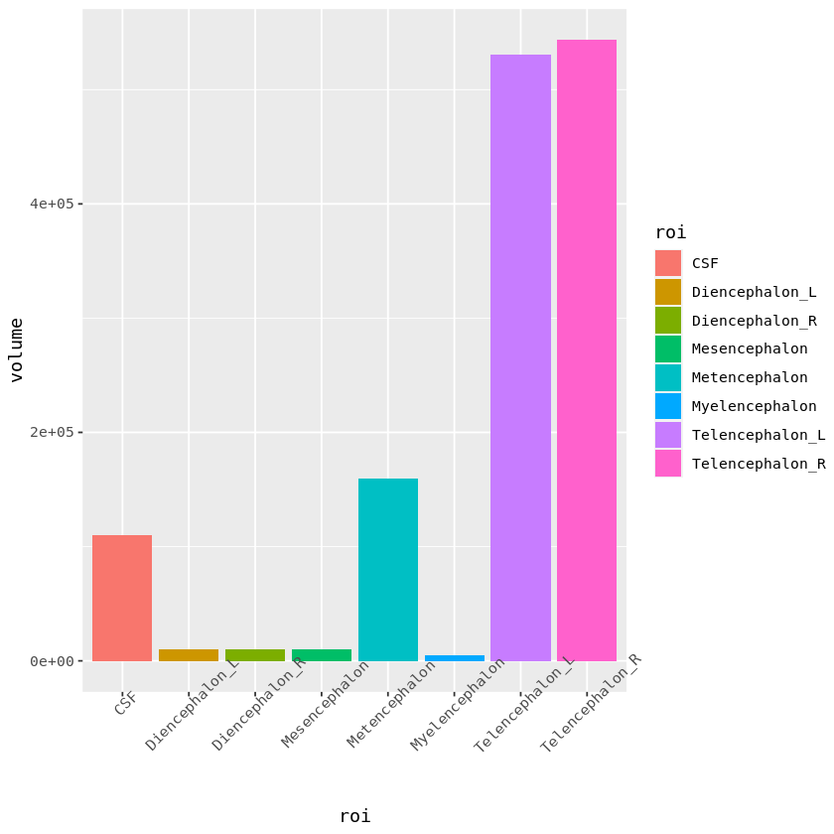
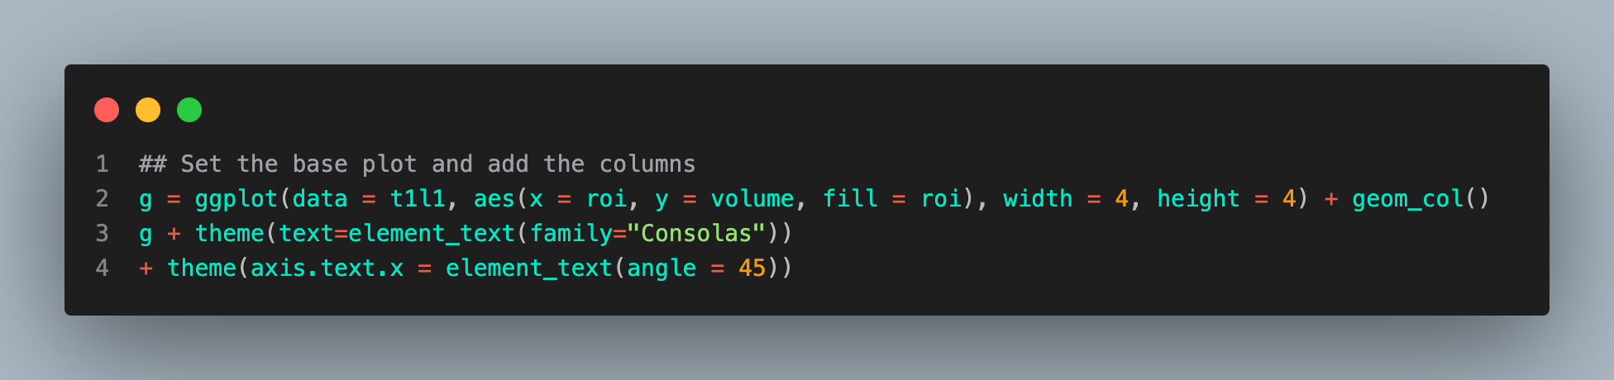
Plotting using ggplot
Below, we create a bar plot using ggplot
The first line creates the base plot then adds the columns
The second line sets some style choices (font and axis font orientations)

